Slide 1

Real time action recognition with ML
Comp 4531 Project
Chong Shing Tai (20854213)
Chong Shing Yuk (20870114)
Ho Po Wa (20886333)
Ng Wing Huen (20792037)
1

Slide 2

Agenda
Introduction
Data collection and System Desgin
Model training and results
Technical challenges
Division of Work
Conclusion
2

Slide 3
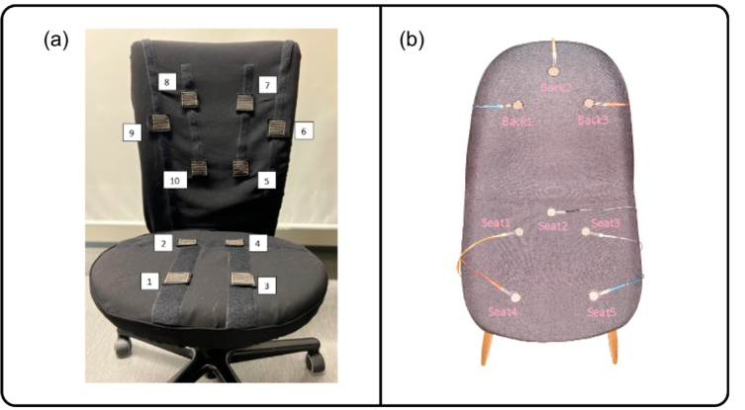
Introduction
long working/ study hours (>8 hours) contributing to long-term sitting
simple sitting activity, if not monitored properly, can result in back pain, neck pain, shoulder pain or even some serious musculoskeletal disorders
ML helps identify poor sitting postures in real time
Target users: office workers and students (young people)
Compare with previous work: Pressure sensor
Not general (different body shape?)
Limited postures (difficult to extend)
each time need to set up a chair one by one?
3

Slide 4
Objective
To develop a lightweight, camera-only, sensor-free action recognition system for daily activity monitoring while minimize the disturbance of normal routine
To provide real-time feedback and posture correction alerts through sound notifications.
4

Slide 5
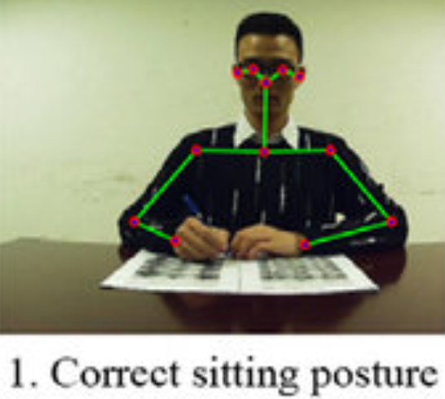
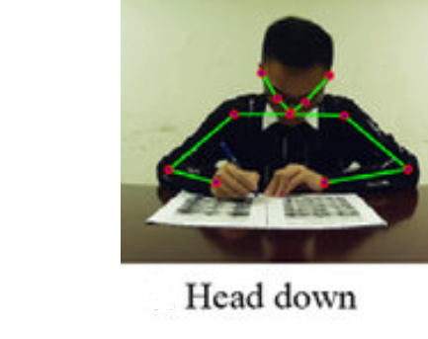
Dataset and labels
Label | Posture
0 | Correct posture
1 | Head down
2 | Turning
3 | Leaning
4 | Head tilted
5 | Sloping shoulder
6 | Lying down
7 | Hands up
Python + OpenCV + MediaPipe Pose used
Each frame records:
X and Y coordinates of 33 landmarks → 66 features
A labeled posture class
5

Slide 6
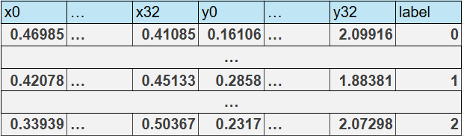
Implementation
Dataset:
4700 total frames with 8 labels
Each sample = 50 frames (captured at 0.2s intervals)
for per-video = 94 samples
Stored in CSV for easy preprocessing
6

Slide 7
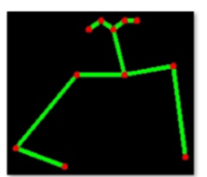
Hardware Implementation
Originally designed for Raspberry Pi 4 + IMX219 camera
Replaced with laptop and webcam
Workflow:
Run Python in virtual environment (venv)
Capture frame every second
Extract pose via MediaPipe
Classify using trained model to handle bad posture by alert
Store classified postures into CSV
Summarize session at the end
7

Slide 8
Model training
Input: skeleton data (33 pose landmarks in x,y directions)
method 1: per-frame classification (66)
method 2: per-video classification (50,66)
LSTM (Video-based classification)
Input: 50 frames (each with 66 features)
Layers:
LSTM (128) → return sequences
LSTM (64)
Dense (64) + ReLU
Dropout=0.2
Dense (8) + Softmax
MLP (Per-frame classification)
Input: 66 features (1 frame)
Layers:
Dense (128) + ReLU
Dense (64) + ReLU
Dense (8) + Softmax
8

Slide 9
Implementation
MLP (Per-frame)
Reliable feature extraction using MediaPipe
Well-labeled dataset with balanced class distribution
Model generalizes well to unseen per-frame data
Fast inference suitable for real-time applications
9

Slide 10
Implementation
LSTM (Pre-video)
50 frames used per input sequence
Final prediction by majority vote
Trained for 100 epochs with dropout (0.2) to reduce overfitting
10

Slide 11
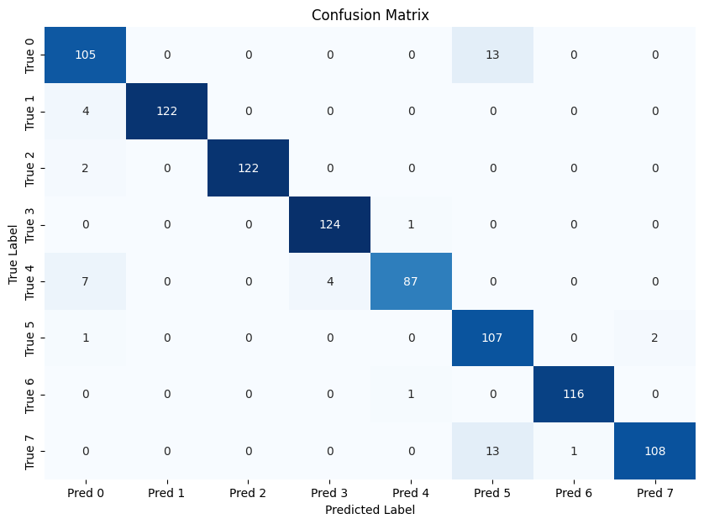
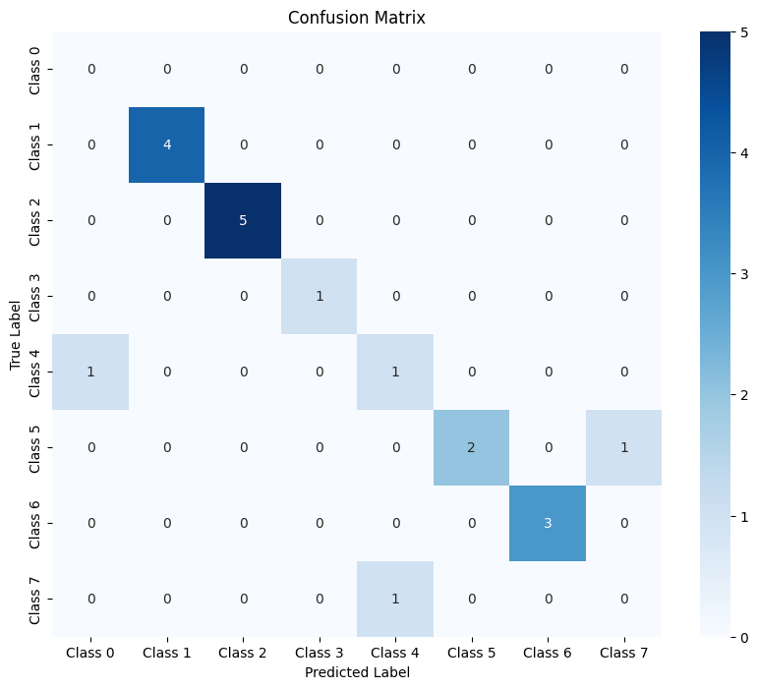
Results
Per-frame
Accuracy: 94.79%
Per-video
Accuracy: 84.21%
11

Slide 12
Technical Challenges
Real-Time Processing on Limited Hardware:
Pose estimation (OpenPose) is computationally expensive.
MediaPipe Pose for real-time inference supports only CPU.
Data Privacy & Storage Constraints:
Converting raw video frames to skeletal data ensures privacy
Model Accuracy:
Small dataset may lead to low accuracy or overfitting
System Incompatible:
Libraries are not fully compatible with the target hardware platform
12

Slide 13
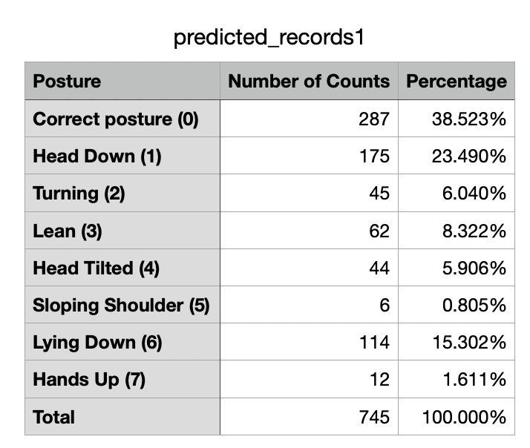
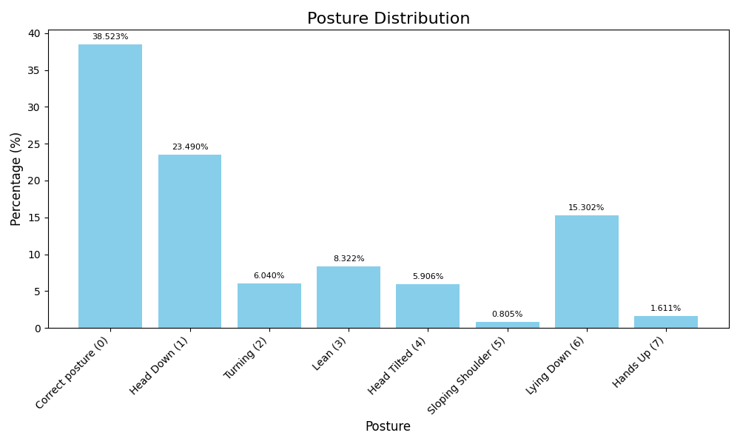
Records as csv and histogram
13

Slide 14
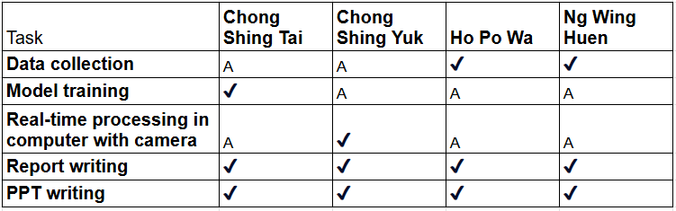
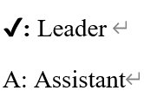
Division of Work
14

Slide 15

Demo
15

Slide 16
Thank you!
16

